Slide 1

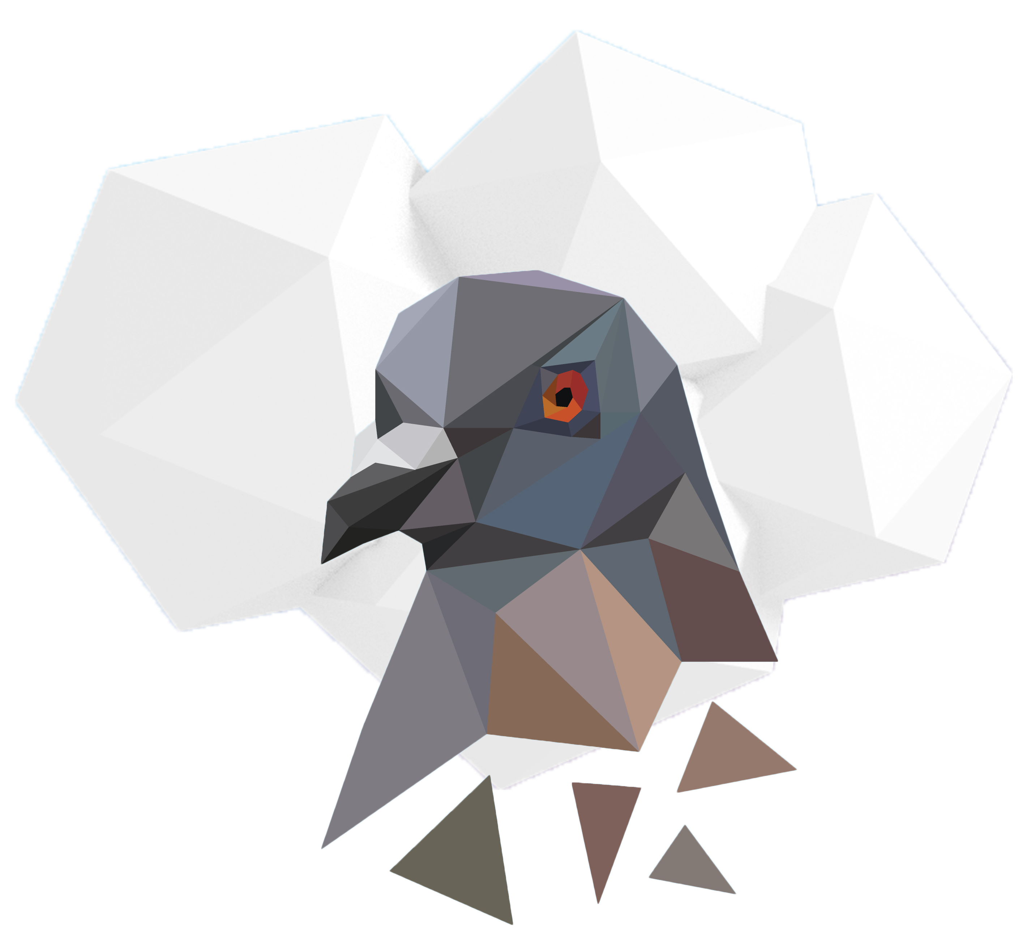
Pigeon Cloud
CHALLENGE
DATA CONCIERGE
Notes:
Note?
Before you open this template be sure that you have installed these fonts:
All fonts are free for :
Montserrat :https://www.google.com/fonts/specimen/Montserrat
Raleway :https://www.google.com/fonts/specimen/Raleway
Note: How to change transparent image? Just Right click in blank area inside slide then go to “format picture” now you can see Format Background panel right side. Then click on Fill & line paint bucket icon and click on File button for choosing your image. You can also change transparency.
If you have any problems with this presentation, please contact with me from this page: http://graphicriver.net/user/haicamon

Slide 2
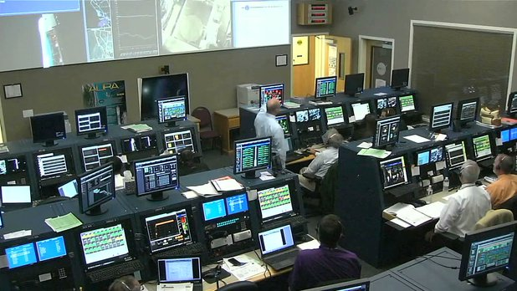



WHAT ?
Artificial Intelligence - AI
DATA CONCIERGE
Requirements are that we design an Artificial Intelligence that can:
Map the data
Learn from it
Help consumers
MAP
LEARN
HELP
Notes:
Note: In this slide there is a Orange Box for change image/place. Right Click to the Orange Box then go to Fill>Picture.. and choose an image from computer.
When add an image, select image go to Format Picture Tool>Crop>Fill

Slide 3



WHY ?
Artificial Intelligence - AI
REASONS?
Help tag, classify and sort huge amounts of scientific earth data.
Make it easier to find and available ( Open Data )
Instruct how to use it !
TAG
SEARC & FIND
TEACH
Notes:
Note: In this slide there is a Orange Box for change image/place. Right Click to the Orange Box then go to Fill>Picture.. and choose an image from computer.
When add an image, select image go to Format Picture Tool>Crop>Fill

Slide 4

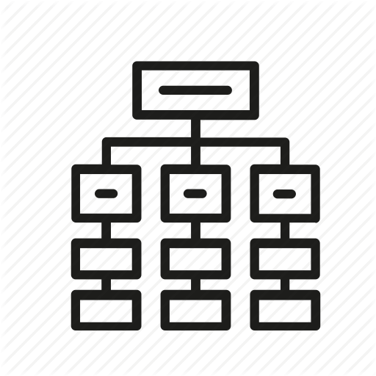




HOW ?
Artificial Intelligence - AI
HOW ?
Read the Data
Analyse the Data
Apply Fancy Math to it!!!
Categorize it
Index it for better & faster querying
Hope the AI learns from it!
READ
ANALYSE
MATH
CATEGORIZE
INDEX
LEARN AI
Notes:
Note: In this slide there is a Orange Box for change image/place. Right Click to the Orange Box then go to Fill>Picture.. and choose an image from computer.
When add an image, select image go to Format Picture Tool>Crop>Fill

Slide 5
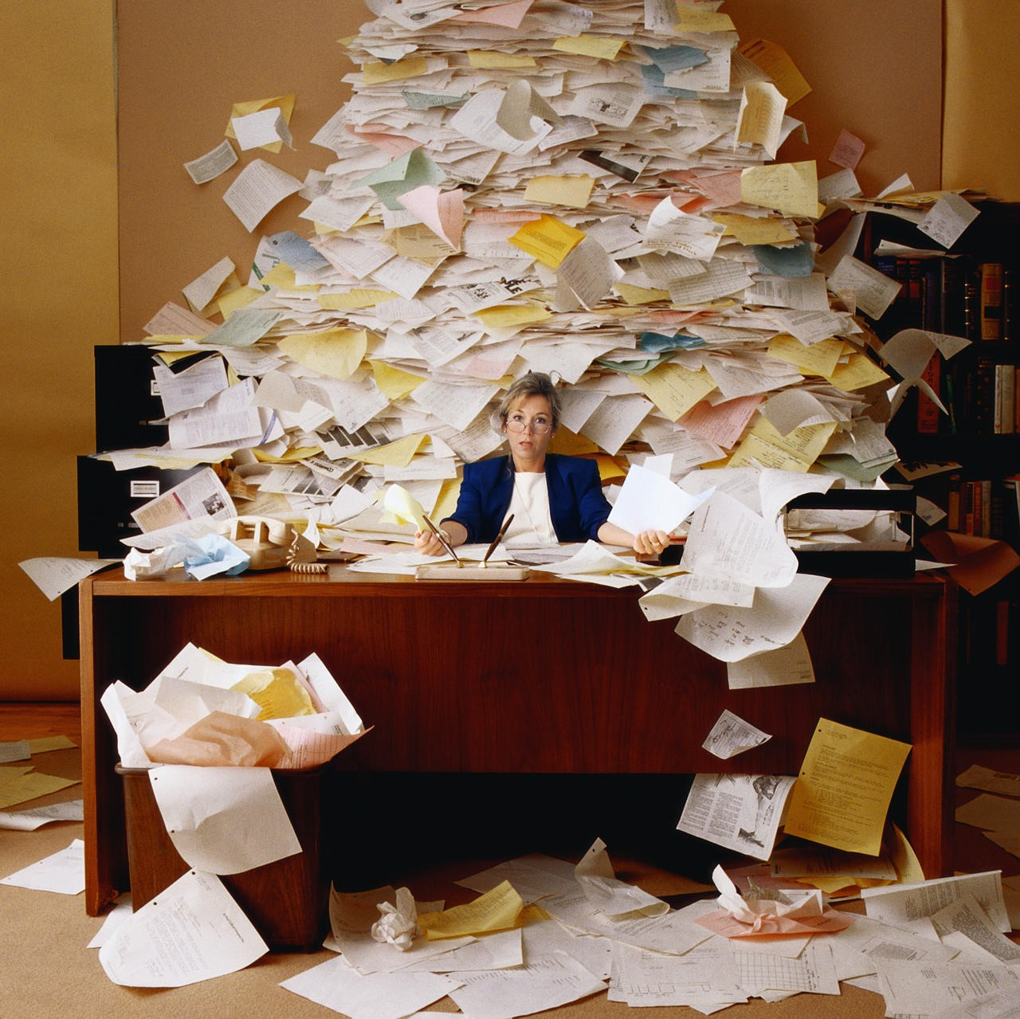
READING THE DATA
ArtificialInteligence - AI
We can access the date from publicly available API’s from the following two links:
https://data.nasa.gov/data.json
https://cmr.earthdata.nasa.gov/search/
AND IT LOOKS LIKE THIS

Slide 6
ANALISING THE DATA
Artificial Intelligence - AI
Extract Keywords
Analyse each Word
Extract Keyphrases
Do smart calculations.
Read Data
Analyse each Phrase
Find similar Keywords
Optimize found data
Count the keyword occurance count
Analyse each Paragraph
Save in database ( Index )
Calculate keywords importance
Notes:
s

Slide 7


APPLY MATHEMATICAL CALCULATIONS
Artificial Intelligence - AI
Once we have the worrds or ”keywords” that are most used. We’re ready to apply some math to calculate their importance to the Data and the probabilities that they might be helpful on our goal.
The math looks something like this…. And it’s very confusing.
You apply this to about a billion Keywords and Phrases and a couple of Hours later
you end up with numbers that signify the relevance of every keyword to every sentence and paragraph.

Slide 8
Implement
Biz Counsel Power Point Template
Import to Database
Cross-Reference
Based on the weights and the word similarities, link the calculated data with every dataset from NASA
Implement a syntasical natural lerning tool kit model based on the data that we need to process
Code AI Learning Model
Feed the model with the data that we previously calculated and stored in a database.
Feed the model
Pray that the AI learns something from the model
Notes:
Note: In this slide there is a Orange Box for change image/place. Right Click to the Orange Box then go to Fill>Picture.. and choose an image from computer.
When add an image, select image go to Format Picture Tool>Crop>Fill

Slide 9
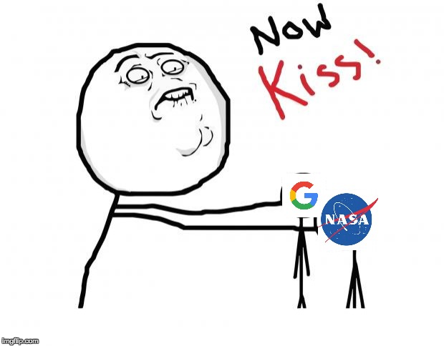
See if you’ve succeded!
Artificial Intelligence - AI
Once it’s done processing all the data that has been fed to it. The only way for us to check if it’s working is to put it to use and see the accuracy of the information.
The way that it should work is that we input a keyword or search phrase related to what we’re trying to find, and it should use that information to find exactly that information or a close estimate to it in case if exact isn’t present.
So basically it’s like Google, just for NASA.

Slide 10



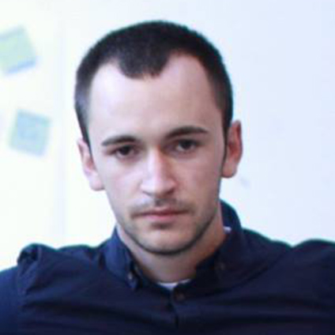

Evil Masterminds
Pigeon Cloud
Axhi Usein
Denis Bajrami
Arbnor Grubi
Ljupcho Kozheski
Muamer Bajrami
Graphic Designer,
Web and Mobile Developer
Web Developer,
Machine Learning and
Hardware Developer
BSC Software Engineer
Handsome Devil
Grapic Designer, Web and Mobile Developer
Web and Mobile Developer,
Machine Learning and
Hardware Developer
Notes:
Note: In this slide there is a Orange Box for change image/place. Right Click to the Orange Box then go to Fill>Picture.. and choose an image from computer.
When add an image, select image go to Format Picture Tool>Crop>Fill

